Slide 1
File Manipulation Tools

Slide 2
cat
Concatenate command
Commonly used to read files
Example: cat sherlock.txt
This command will display the text file sherlock.txt in the terminal
Also used to combine files
Example: cat bill1754.txt > constitution.txt
This command will put the bill1754.txt into the constitution.txt file

Slide 3
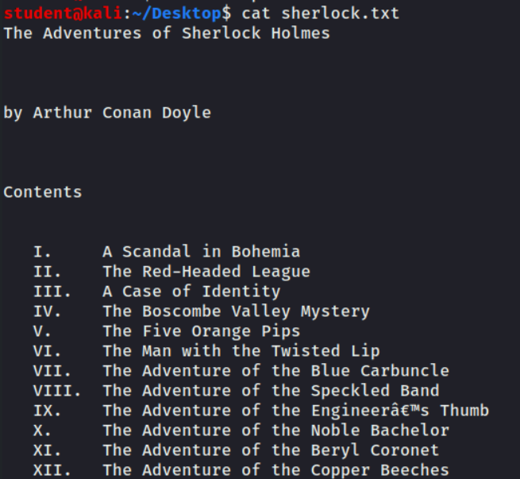
cat
Screenshot of running cat sherlock.txt
Notice the text is displayed in the terminal

Slide 4
cat
Screenshot of running cat panda.txt > sherlock.txt
The contents of panda.txt will have been copied and stored as a file sherlock.txt (this will overwrite a file)
Screenshot of running cat panda.txt >> sherlock.txt
The contents of panda.txt will have been copied and stored at the end of file sherlock.txt (this will not overwrite a file)

Slide 5
head and tail
head command
Show the first few lines of a file
Default is 10 lines
-n will change the number of lines
tail
Show the last few lines of a file
Default is also 10
-n will change the number of lines

Slide 6
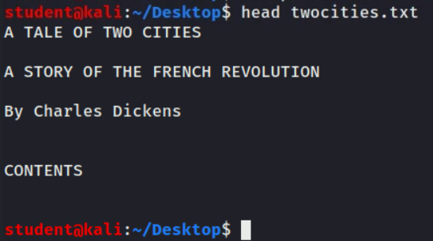
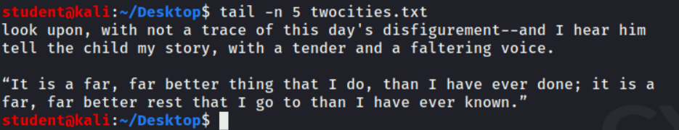
head and tail
Screenshots of running head (default of 10 lines) and tail (specifying 5 lines)

Slide 7
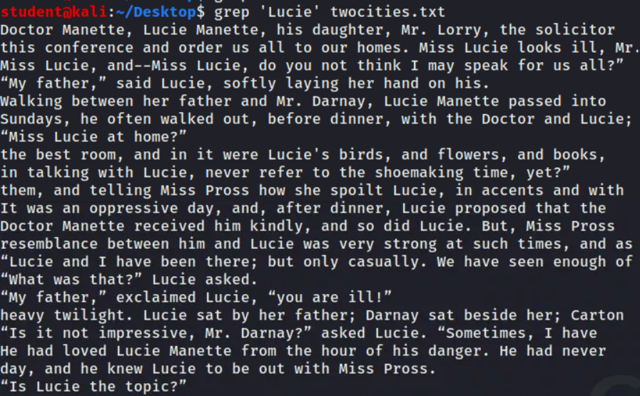
grep
Searches for patterns
Commonly used to search for a string of text
Screenshots of running grep searching for all patterns of “Lucie” in twocities.txt text. Every line with “Lucie” is displayed

Slide 8
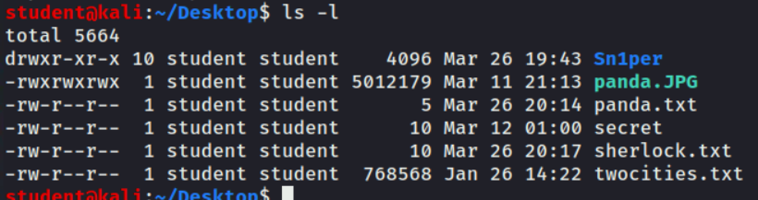
chmod
Change Mode
Controls permissions a user has
Numerically
1 - execute, 2 - write, 4 - read
Add them up
Letters
x - execute, w - write, r - read
Combine letters for combination
ls -l will display the permissions for the users

Slide 9
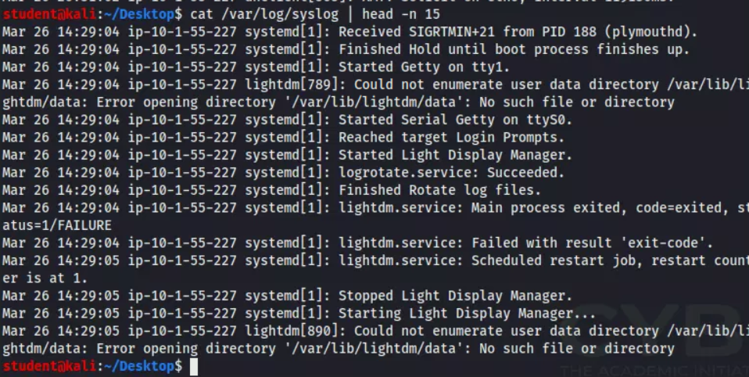
logger
Allows a user to enter messages into the system log
Default location: /var/log/syslog
Displaying the first 15 lines of the default syslog on a system

Slide 10
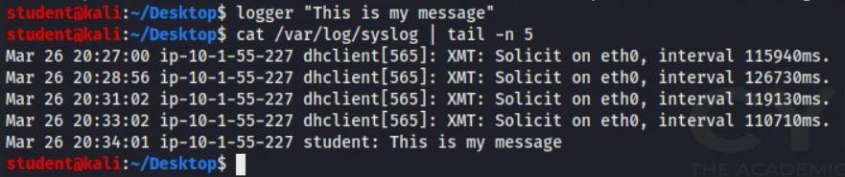
logger
Using logger to log a message and then viewing the last 5 lines of the syslog
Notice the message was added to the syslog

Slide 11
Shell and Script Environments

Slide 12
Shells and Scripts
Shell
How a user interacts with an environment
Two types
Graphical User Interface (GUI)
User clicks buttons
Command Line Interface (CLI)
User types commands to interact with environment
Typically, a shell is a CLI
Script
A series of commands that automate a task for the user

Slide 13
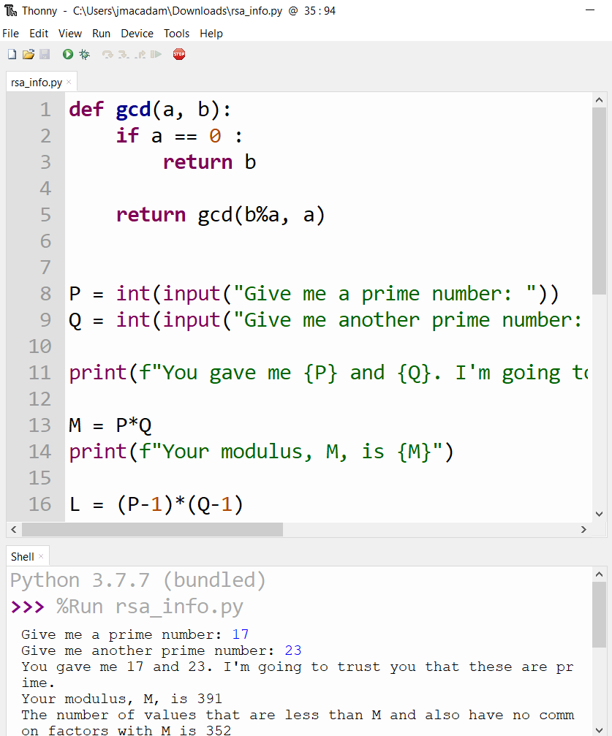
Python
Scripting language
Pre-installed on most OS
.py is the file format
Example of a Python script running in Thonny

Slide 14
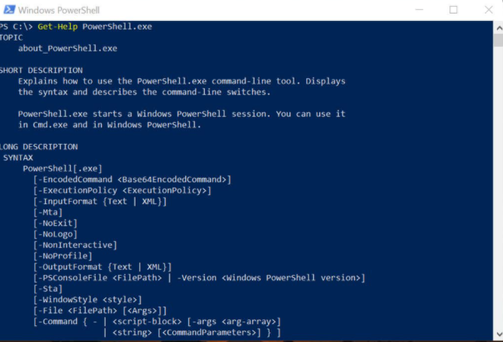
Powershell
CLI for Windows OS
Scripting language inside shell environment
.ps1 is the file format
Inside the PowerShell environment

Slide 15
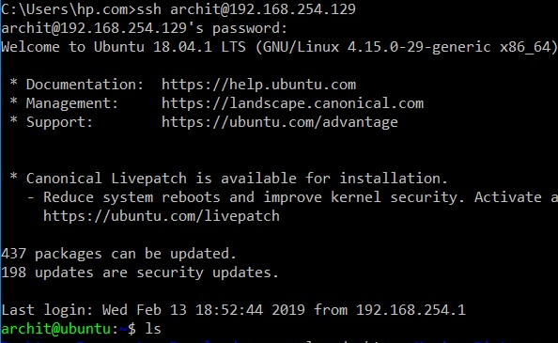
SSH
Secure Shell
A shell that allows a user to remotely connect and control another system
Accessing another system via SSH

Slide 16
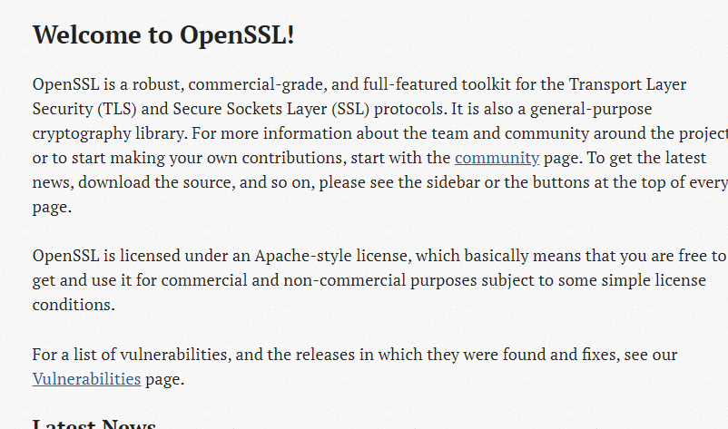
OpenSSL
Not a shell or scripting language
Security that HTTPS websites use to encrypt data
OpenSSL’s front page of their website where you can download their latest versions

Slide 17
Network Reconnaissance and
Discovery Tools

Slide 18
ipconfig and ifconfig
To determine the IP address or network connection status of a system, use one of the following tools
ipconfig – Windows TCP/IP configuration
ifconfig – Linux interface configuration
ip – Linux tool similar to ifconfig but more functionality
These tools can tell you if you have an IP address, allow you to reset a DHCP assignment, assign a static IP address, determine your interface’s MAC address and more
A fair amount of network troubleshooting involves use of these tools

Slide 19
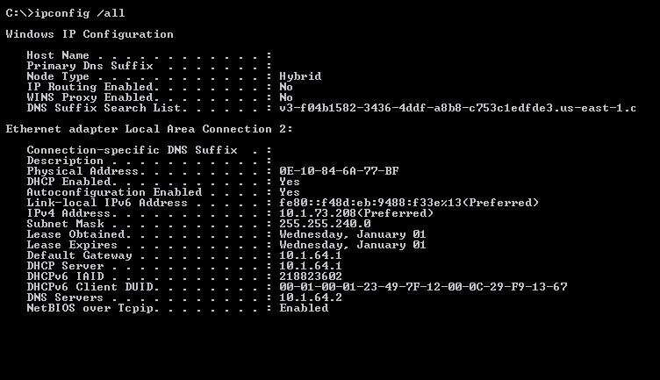
Screenshot of running ipconfig /all on a Windows system

Slide 20

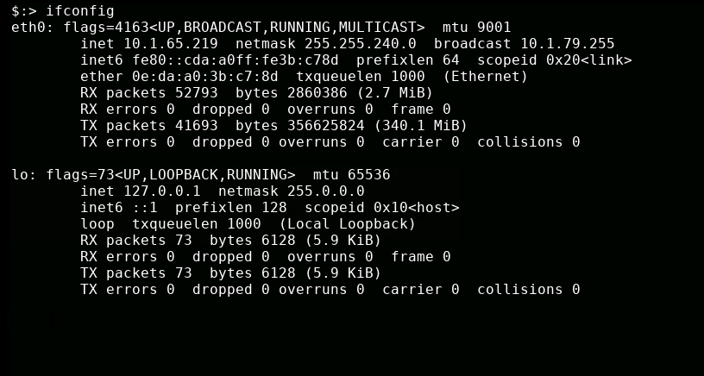
Screenshot of running ifconfig on a Linux system

Slide 21
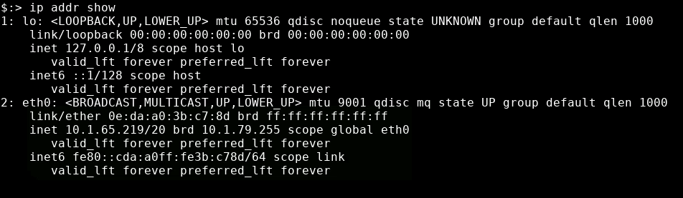
Screenshot of running ip link show on a Linux system
Notice this displays the status of network link layer devices
Screenshot of running ip addr show on a Linux system.
Notice this displays the addresses assigned to the devices.

Slide 22
ping
Tests network connectivity by sending an echo request via Internet Control Message Protocol (ICMP) to the specified host
Tool responds with round-trip time (in milliseconds)
1ms = 1/1000 second
Also provides Time To Live (TTL) of the ICMP request
TTL varies by operating system:
Windows = 128
Linux = 255
Mac = 64
hping
Used to test the security of a network
Allows the pentester to create their own TCP/IP packets in order to test certain things

Slide 23
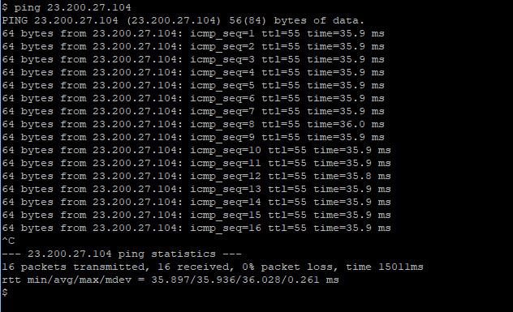
Screenshot of running ping on a Linux system.
Notice Linux will continually ping a system until stopped by a user

Slide 24
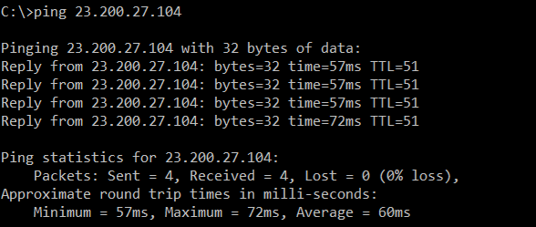
Screenshot of running ping on a Windows system.
Notice Windows will only send 4 ping requests

Slide 25
traceroute
Determines path a packet takes to a destination
traceroute on Linux
tracert on Windows
tracepath on Chromebook
Uses ICMP Time to Live Exceeded error message
TTL refers to number of hops, not actual time
Not always accurate
Some networks block ICMP requests
Some networks deprioritize ICMP requests
Hops not responding shown with asterisk ( * )

Slide 26
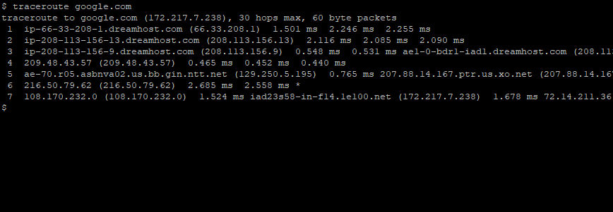
Screenshot of running traceroute on a Linux system

Slide 27
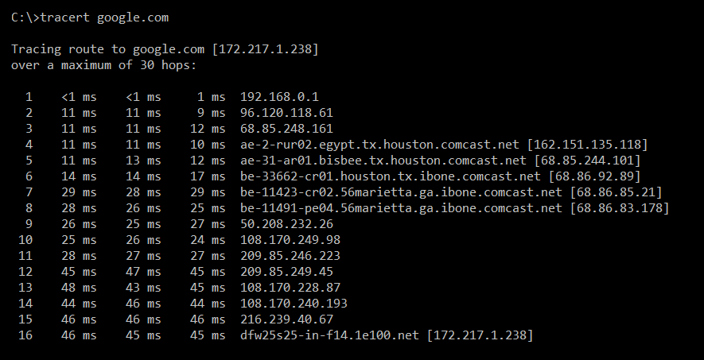
Screenshot of running tracert on a Windows system

Slide 28
nslookup and dig
Query DNS servers
“What is the IP address for <hostname> ?”
nslookup
Simple lookup of domain names and matching IP addresses
dig
Domain Information Groper
More detailed domain information
A record : Address of network
MX record : “mail exchange” (server than handles inbound email)
NS record : name servers (DNS) responsible for this domain
TXT record : notes for other networks to reference (serves many purposes)
SOA record : Start of Authority, the primary authoritative DNS server

Slide 29
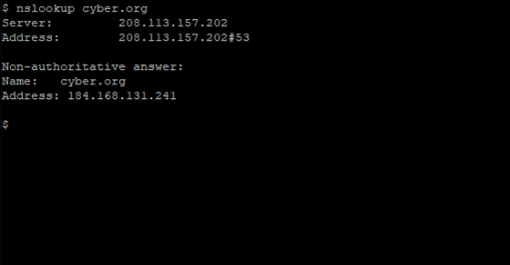
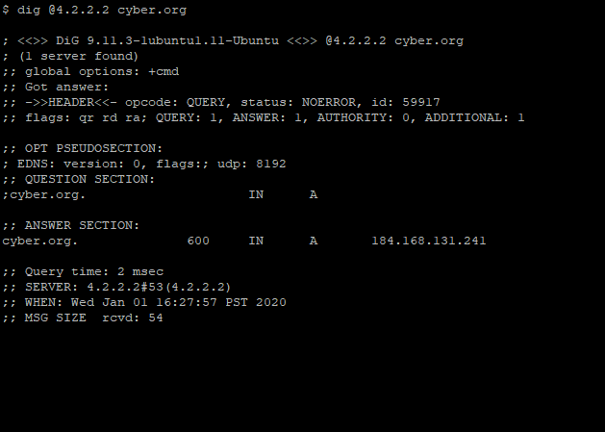
Screenshots of running a nslookup and a dig on cyber.org’s website

Slide 30
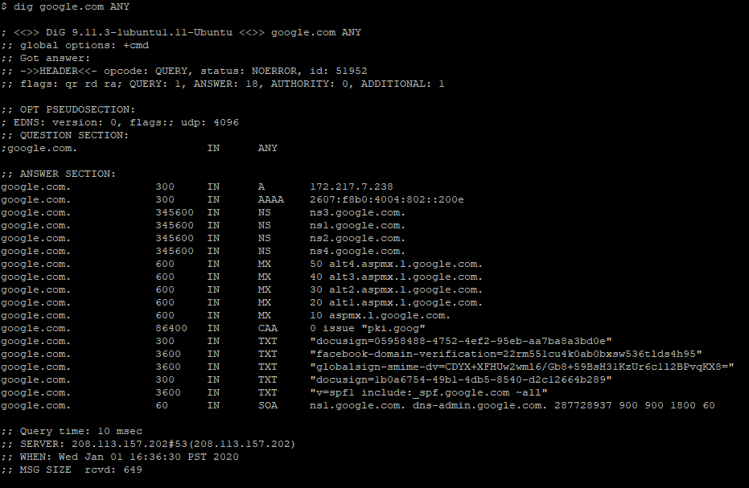
Screenshot of running a dig ANY command
Notice how much more information is provided

Slide 31
arp
Address Resolution Protocol (ARP)
arp command allows you to view/modify the arp table on the host
arp
View host’s ARP table, formatted into columns
arp -a
View host’s ARP table, no columns
arp -n
Show numeric address, do not resolve hostnames
arp -d <ip_addr>
Remove ip_addr from ARP table

Slide 32
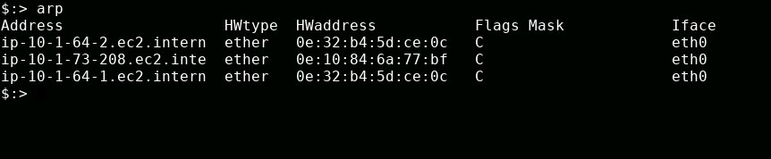
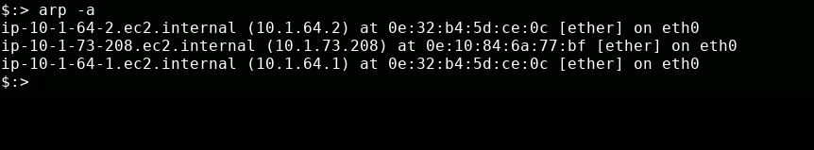
Screenshot of running an arp command
Screenshot of running an arp -a command

Slide 33
route
Shows a system’s routing table and allows a user to modify
A routing table is data stored on a network (typically on the router)
Lists routes to different hosts on that network
Using route, a user can view certain routes and alter them for various reasons

Slide 34
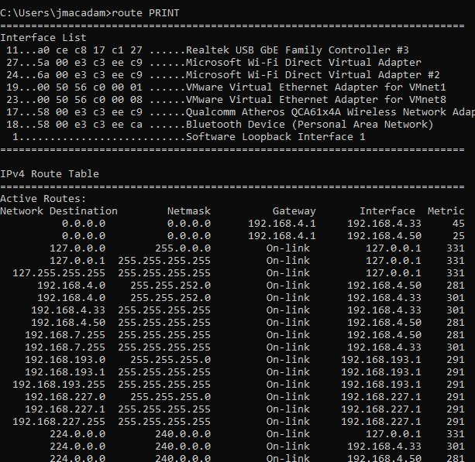
Screenshot of running a route PRINT command on a Windows system

Slide 35
netstat
Monitors network connections to and from host
Network statistics
Displays all ports host is listening on
Many options
netstat -a
Show all active connections
netstat -at
Show all active TCP connections
netstat -n
Do not resolve names

Slide 36
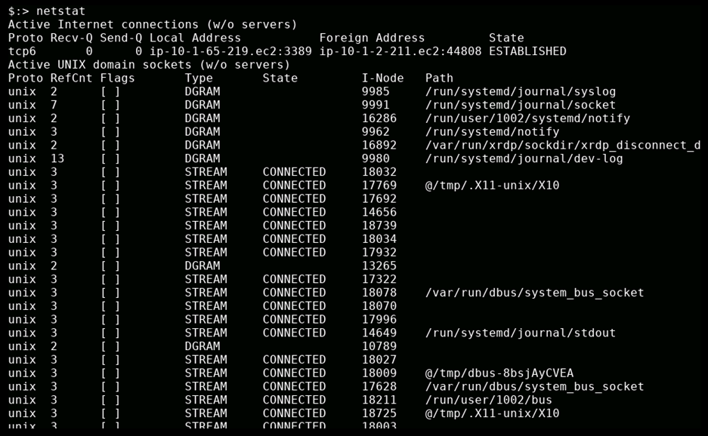
Screenshot of running a netstat command

Slide 37
nmap
Network Mapper
Search for hosts on a network
Scan range of IP addresses
Rogue system detection (“Wait, who is that IP address?”)
Scan for open ports on host
Identify services available on a host
Fingerprint operating systems
“What’s OS is behind that IP?”
NSE files (nmap scripting engine) allows for more specialized scans, helps filter complex queries

Slide 38
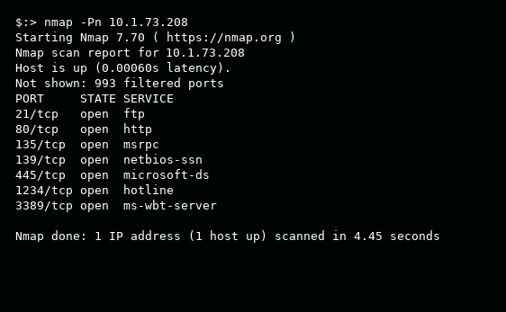
Screenshot of running a nmap command

Slide 39
Nessus
Similar to nmap, scans a system
Finds open ports, protocols, versions, etc…
Also scans for vulnerabilities
Shows how to patch discovered vulnerabilities
Open-source software
Used alongside other tools
Nexpose
OpenVAS

Slide 40
netcat
Read and Write directly to network interface
Open port and communicate directly via TCP or UDP packets
Versatile tool – command is actually nc
Monitor a port
Transfer data via a port
Simple port scan
Basic telnet client
Quick, easy backdoor
Select port to operate on
Open a “hotline” service for remote connection
Transfer plain text through netcat backdoor

Slide 41
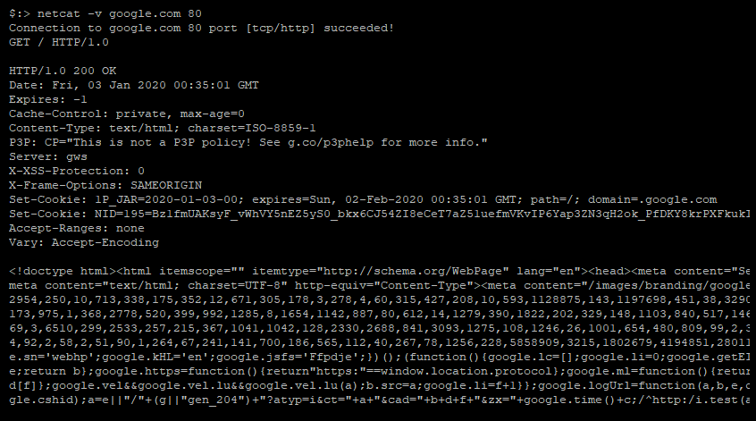
HTML header information
HTML contents
Screenshot of running a netcat command

Slide 42
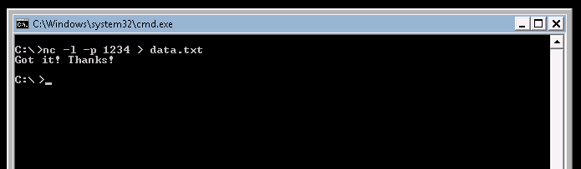

nc – Windows host creates “listen” server on port 1234 Stores incoming data in data.txt file When data arrives, user sends message saying file received
nc – Linux host connects to server over port 1234 Sends contents of data.txt file Sees message from recipient saying file received CTRL+C closes connection

Slide 43
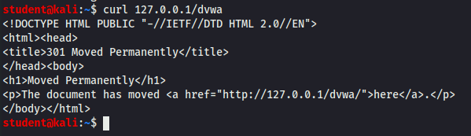
curl
Tool used to transfer data from one server to another
Variety of protocols
HTTP, IMAP, SMTP, etc
Screenshot of running a curl command
Notice a simple curl command will fetch headers

Slide 44
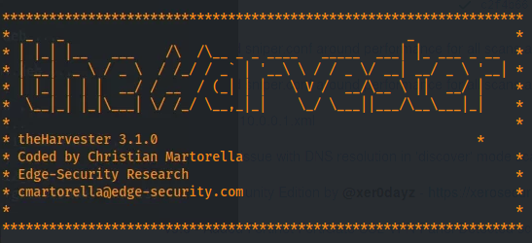
Data Gathering Tools
theHarvester
Open-source tool that gathers information about a company or domain
Similar to running a Google search or social media search into a company
Scanless
Uses multiple port scanners to run the scans for you
Does not give up your IP Address

Slide 45
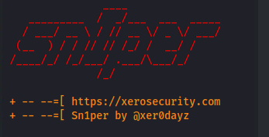
Data Gathering Tools
Sn1per
Combines tools
whois, ping, nmap, etc…
Can be traced back to user
dnsenum
Finds DNS records and other information
Gathers all the servers and DNS entries for an organization

Slide 46
Cuckoo
Sandboxed environment that a company is able to put a file into and find out how it will act in the isolated environment
Can use this tool to test out programs before putting them on their networks and figuring out if they are malware or not

Slide 47
Packet Capture and Replay Tools

Slide 48
tcpdump and Wireshark
Packet analyzers
Filters give ability to only view certain packet types
Record network traffic and write to pcap file
Very useful, usually for feeding into another tool
tcpdump
Command Line Interface (CLI)
Wireshark
Graphical User Interface (GUI)

Slide 49
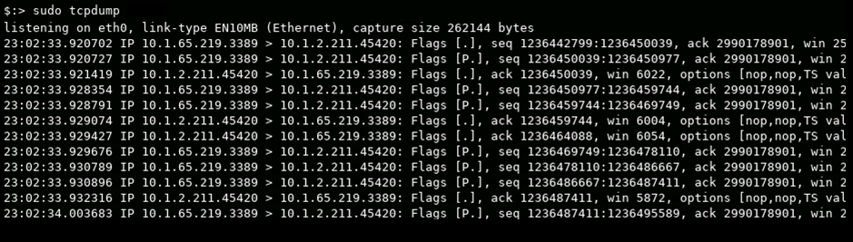
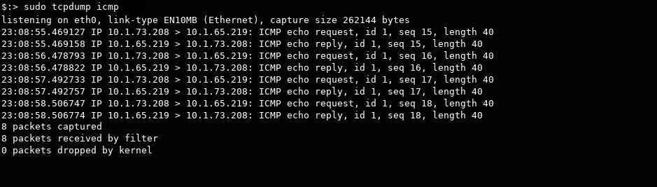
Using the command tcpdump –nn to show all packets
Using the command tcpdump icmp to watch for only ICMP packets
Notes:
tcpdump –nn will not resolve hostnames or port names, just show where the activity is
tcpdump icmp shows only icmp traffic (or, tcp, udp…) tcp port 53 to capture DNS traffic (can also see what domains the host is trying to find IP address for)

Slide 50
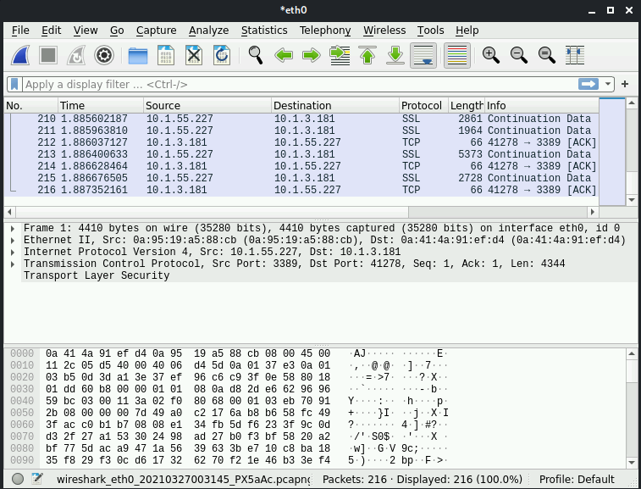
Using Wireshark to capture and analyze packets
Notes:
tcpdump –nn will not resolve hostnames or port names, just show where the activity is
tcpdump icmp shows only icmp traffic (or, tcp, udp…) tcp port 53 to capture DNS traffic (can also see what domains the host is trying to find IP address for)

Slide 51
tcpreplay
Captures network traffic
But also replays the packets
Packets can be modified
Then replayed with the altered packets
Powerful for malicious actors
Replay authentication packets

Slide 52
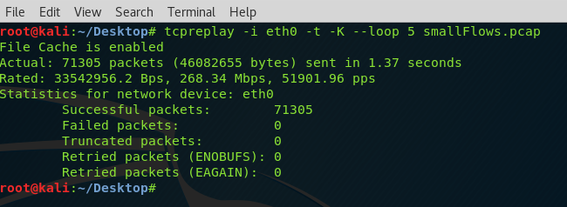
Using tcpreplay to replay previously captured packets

